Slide 1
Tech Quiz
QM: Tanmay Pereira Naik

Slide 2
Acknowledgements
Rahul Hulli
Saheel Wagh
CURSOR

Slide 3
Round 1 – Written
Write all answers on the given sheet
+5 for each correct answer, no negatives
Exchange papers at the end

Slide 4
1
Ericsson, a Denmark based company started working on a device that established radio links between portable devices. Jim Kardman named the technology _________ after the 10th century Viking king Harold Blatand, who liked eating blueberries. FITB.

Slide 5
2
This OS is the smallest in the world in terms of size, being of just 1.44MB, enough to store into a floppy disk, and also having a proper GUI

Slide 6
3
This computer virus, known to be appealing, was deployed as a fake love letter to its victims, once deployed, would overwrite all the important data with the copy of its own.

Slide 7
4
This system is the master program that controls the computer's resources, allotting them to different users and to different tasks, doesn't interact directly with user space

Slide 8
5
This computer enthusiast, came up with the first of desktop designs of the 20th century, being the CEO of the company for a few years, only to be kicked out by the same company, which he claims his turning point towards making another, which now supports one of the top 3 operating systems in the world

Slide 9
6
This OS, most popular in the world after Windows, uses customized Linux 3.6 Kernel.

Slide 10
7
Which company was the first to produce a handheld mobile phone in the 1970s?

Slide 11
8
This OS is popular as the Indian version of Linux, still under development, has its developmental base in Chennai.

Slide 12
Answers!

Slide 13
1
Ericsson, a Denmark based company started working on a device that established radio links between portable devices. Jim Kardman named the technology _________ after the 10th century Viking king Harold Blatand, who liked eating blueberries. FITB.

Slide 14
“Bluetooth”, because of the teeth coloration after eating blueberries.

Slide 15
2
This OS is the smallest in the world in terms of size, being of just 1.44MB, enough to store into a floppy disk, and also having a proper GUI

Slide 16
KolibriOS

Slide 17
3
This computer virus, known to be appealing, was deployed as a fake love letter to its victims, once deployed, would overwrite all the important data with the copy of its own.

Slide 18
ILOVEYOU

Slide 19
4
This system is the master program that controls the computer's resources, allotting them to different users and to different tasks, doesn't interact directly with user space

Slide 20
Kernel

Slide 21
5
This computer enthusiast, came up with the first of desktop designs of the 20th century, being the CEO of the company for a few years, only to be kicked out by the same company, which he claims his turning point towards making another, which now supports one of the top 3 operating systems in the world

Slide 22
Steve Jobs

Slide 23
6
This OS, most popular in the world after Windows, uses customized Linux 3.6 Kernel.

Slide 24
Android

Slide 25
7
Which company was the first to produce a handheld mobile phone in the 1970s?

Slide 26
Motorola

Slide 27
8
This OS is popular as the Indian version of Linux, still under development, has its developmental base in Chennai.

Slide 28
Bharat Operating System Solution (BOSS)

Slide 29
Round 2
Infinite Bounce
+10/-0

Slide 30
1
When the Internet was still very much of a skeleton, a group of scientists at CERN started working on the WWW. In an office on the fourth floor, they placed the WWW’s central database. Some faulty requests were answered with the error message: “_____ ___ ___ ___”.

Slide 31
Room 404: File not found

Slide 32

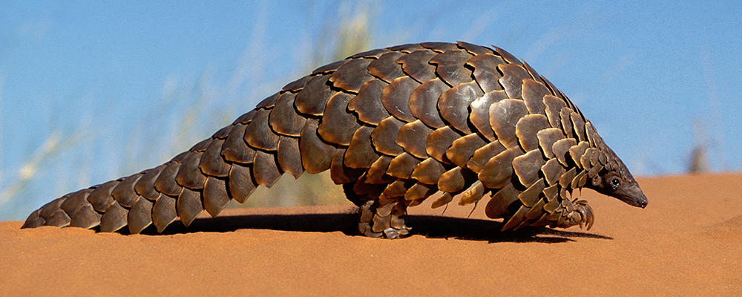
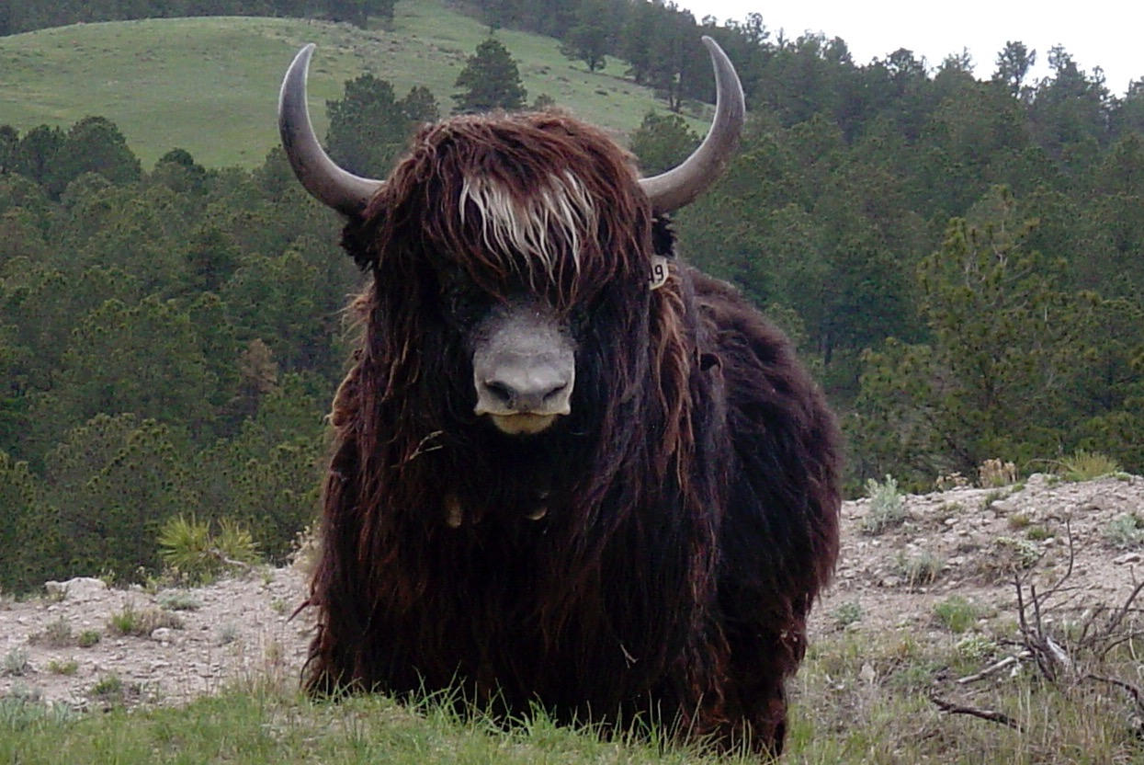
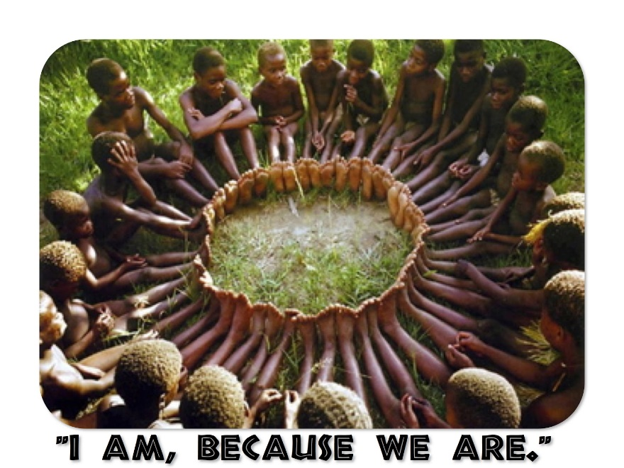
2. Connect

Slide 33
Ubuntu

Slide 34
3
X’s first project was a mobile app called “Field Trip”, which was intended to be a location-based guide to cities.
In an interview during the launch time, X’s CEO Y said that – “the idea behind the app was to build something that would help people connect with the real, physical world around them.”
ID X and Y.

Slide 35
X – Niantic
Y – John Hanke

Slide 36
4
The only legitimate child of the poet Lord Byron , she was an English mathematician and writer, chiefly known for her work on Charles Babbage's proposed mechanical general-purpose computer, the Analytical Engine. She was the first to recognise that the machine had applications beyond pure calculation, and created the first algorithm intended to be carried out by such a machine.

Slide 37
Ada Lovelace

Slide 38
5
This computer worm, is known to infect secondary storage devices external to the system. Various folders get created and the entire data existing in the device hides in a shortcut path.

Slide 39
AutoRun

Slide 40
6
Which symbol is known to be the substitute to curly braces in C program?

Slide 41
Trigraph <?? equivalent to { and ??> equivalent to }

Slide 42
7
This Operating System is the first of its kind, working totally on a hypervisor environment (Virtual-Machine-Like), imitates to be the 'in-between' of Ubuntu (Linux distro) and Windows XP, known currently as the most secure operating system in the world

Slide 43
Qubes OS

Slide 44
8
This Web-Development framework, designed in 2006, uses Python as its backend, and was designed targeting those people who work under journalism, allowing them to easily modify web-pages with recent information within minutes.
It was named after guitarist ______ Reinhardt.
FITB.

Slide 45
Django

Slide 46
9
BBK Electronics is a Chinese MNC specialising in electronics like TV sets, MP3 players, digital cameras and cell phones.
For full points, give me the names of its 3 subsidiaries under which it markets smartphones in India.

Slide 47
Oppo, Vivo, OnePlus

Slide 48
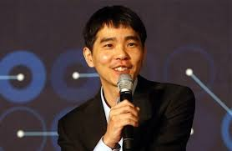
10
Lee Sedol (pic on next slide) is an 18-time world champion of a strategy board game called Go.
“Who” defeated him 1-4 in a series of matches played between 9th and 15th March 2016?

Slide 49
AlphaGo

Slide 50
11
Speaking of iconic matches with AI-driven computers, chess grandmaster Garry Kasparov was defeated by which supercomputer in 1997?

Slide 51
Deep Blue

Slide 52
12
This open source language developed by Microsoft is a syntactical superset of JavaScript. It brings the features of static types to JS, hence the name. Identify.

Slide 53
TypeScript

Slide 54
Final Round
Infinite Bounce – Reverse Direction
Pounce to Death

Slide 55
1
Herman Hollerith (February 29, 1860 – November 17, 1929) was an American inventor who developed an electromechanical punched card tabulator to assist in summarizing information and, later, accounting. He was the founder of the Tabulating Machine Company that was amalgamated in 1911 with three other companies to form a fifth company, the Computing-Tabulating-Recording Company, later renamed as X.

Slide 56
IBM

Slide 57
2
This keyword in C++ is used to resolve name conflict of the identifiers, performs logical division of code

Slide 58
namespace

Slide 59
3
Name the loop used in the design of the first ever computer virus

Slide 60
While()

Slide 61
4
The annual Tour de France cycling race has always had a terrible time with cheats of all kinds. The 2016 edition featured the use of random tests using thermal imaging and magnetic resonance imaging to nab participants who have done what?

Slide 62
Added electric motors to the bicycles

Slide 63
5
From his interview:
Q: There’s a curious story behind your “_____ _____” algorithm....
A: What’s the ____ ____ to travel from Rotterdam to Groningen? It is the algorithm for the ______ _____, which I designed in about 20 minutes. One morning I was shopping in Amsterdam with my young fiancée, and tired, we sat down on the café terrace to drink a cup of coffee… In fact, it (the algorithm) was published in 1959, three years later. The publication is still quite nice. One of the reasons that it is so nice was that I design edit without pencil and paper. Without pencil and paper you are almost forced to avoid all avoidable complexities. Eventually that algorithm became, to my great amazement, one of the cornerstones of my fame. I found it in the early 1960s in a German book on management science— “X’s procedure”. Suddenly, there was a method named after me. And it jumped again recently because it is extensively used in all travel planners. If, these days, you want to go from here to there and you have a car with a GPS and a screen, it can give you the _____ _____.
X is the a Dutch computer scientist who came up with the ______ ____ algorithm. FITB.

Slide 64
Dijkstra’s Shortest Path algorithm

Slide 65
6
This networking system technology, typically used earlier in its lifetime to draw lots and win bets. People from all around the world get connected to it as nodes, and all their data, including thier rewards is shared amongst all other nodes, so that the reward cannot be stolen. This was implemented recently in Russia to book Airline Tickets

Slide 66
BlockChain

Slide 67
7
Captain America’s shield is nearly indestructible. Wolverine’s Adamantium claws are known to scratch it, and it was destroyed only once by a radioactive form of its constituent element.
What fictional element is Cap’s shield made of?

Slide 68
Vibranium

Slide 69
8
New Hampshire-based research and development company DEKA is developing a ‘next generation prosthetic arm’ with a sense of touch. With the help of a $7 million funding from the DARPA, what is this project named?

Slide 70
Luke’s Arm

Slide 71
9
The original X was an American automobile manufacturing company formed by automobile industry executive John X in 1975. It is remembered for the one model it produced — the distinctive stainless steel sports car featuring gull-wing doors—and for its brief and turbulent history, ending in bankruptcy in 1982.
The car featured memorably as the model of car made into a time machine by an eccentric scientist in a popular movie series, although the company had ceased to exist before the first movie was made.

Slide 72
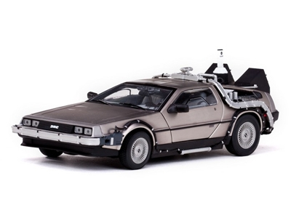
DeLorean Motor Company

Slide 73
10
Formerly known as ‘Legend’, this Chinese multinational decide to change its name to a portmanteau of a part of the old name, and the Latin word for ‘new’. In Chinese, the name means "association” or "connected thinking."

Slide 74
Lenovo

Slide 75
11
This is a gold-plated audio visual disc that carries a truckload of data from around the world.
It includes dozens of photos, a range of scientific information, spoken greetings from people such as the Secretary-General of the United Nations and the President of the United States and a medley, "Sounds of Earth," that includes the sounds of whales, a baby crying, waves breaking on a shore, and a collection of music, including works by Mozart, etc. The record also contains greetings in 55 different languages.
Where is this disc found? (picture on next slide)

Slide 76
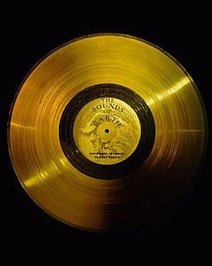

Slide 77
Voyager spacecrafts

Slide 78
12
This Finnish tech giant had humble beginnings as a pulp mill in 1865.
Was known for producing toilet paper before and after WWII.
Which company?

Slide 79
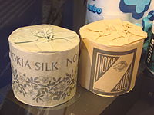
Nokia

Slide 80
Thank you!

Slide 81
In an effort to continue expanding, X created an additional arm of its network called X Cares. It’s a charitable endeavour that donates money based on eyeballs, and raises money for issues such as breast and testicular cancer awareness and research, as well as environmental campaigns like tree planting (“X Gives America Wood” campaign). Its latest charitable effort includes giving away a $25k college scholarship.
This was controversial because X is well-known for something else entirely.
ID X.

Slide 82
PornHub

